Slide 1

Autonomous systems FFNN with GA
Milan Zolota
Software Engineer II

Slide 2
Setup
Go to unity.com – Get started – Download & Install the Free installer
Run the unity hub, Add the latest official release in the installs folder
(If using VS)Run the visual studio installer and install Unity support
Go to https://aka.ms/FFNNGA and download/clone the repo

Slide 3
COntents
Neural Networks
Structure, Evaluation, Learning
Evolutionary algorithms
Genetic algorithms, NeuroEvolution

Slide 4
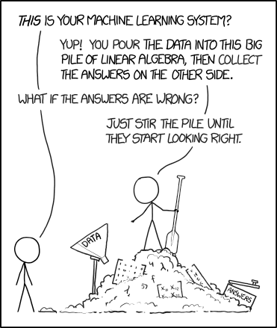
What’s a NN?

Slide 5
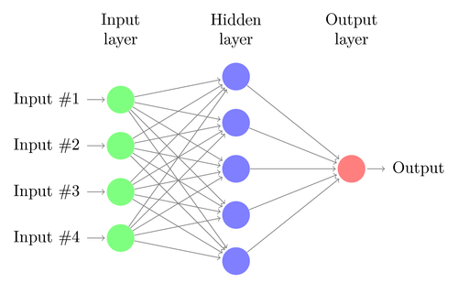
NN - Structure

Slide 6
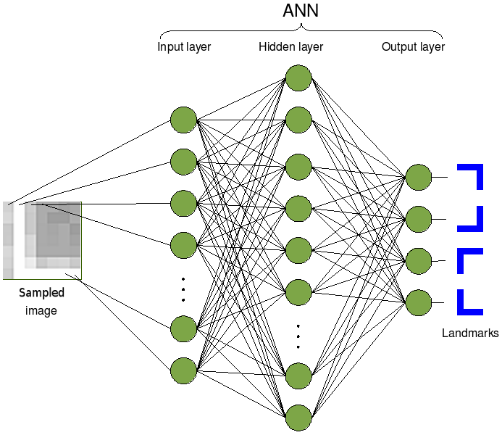
NN - EVALUATION

Slide 7
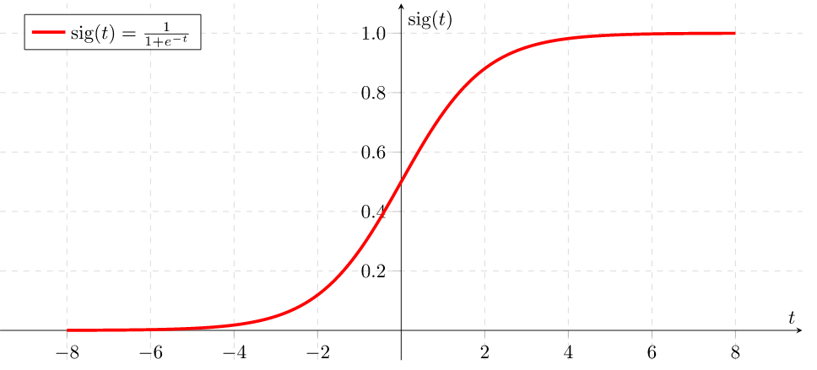
SIgmoid

Slide 8
NN - Learning
Cost function
Minimising the cost
Backpropagation

Slide 9
Setup
Go to unity.com – Get started – Download & Install the Free installer
Run the unity hub, Add the latest official release in the installs folder
(If using VS)Run the visual studio installer and install Unity support
Go to https://aka.ms/FFNNGA and download/clone the repo

Slide 10
Genetic Algorithms

Slide 11
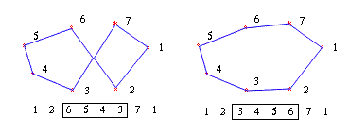
Genetic Algorithms

Slide 12
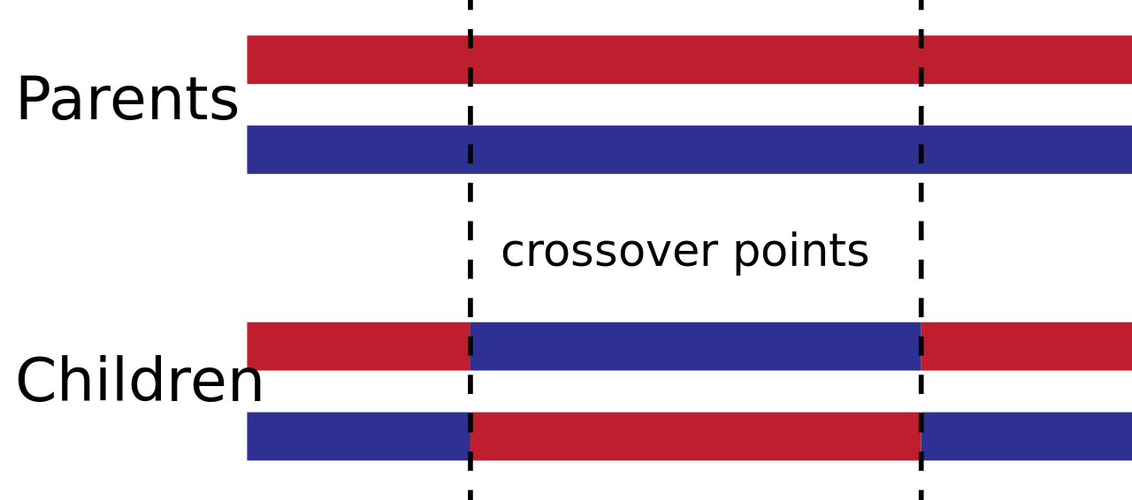
Genetic Algorithms

Slide 13
Setup
Go to unity.com – Get started – Download & Install the Free installer
Run the unity hub, Add the latest official release in the installs folder
(If using VS)Run the visual studio installer and install Unity support
Go to https://aka.ms/FFNNGA and download/clone the repo

